Slide 1
S.M.A.R.T
CMSC 495 - Final Project
5/8/2022

Slide 2
Team and Roles
Primary Coding/Programming:
Samuel Scalf
Chris Ames
Josh Longo
Primary Documentation/ User Guides / Test Planning:
Young Jin Jeon
Akane Amagai
Brian Kilheffer
Primary Project Manager:
Brian Kilheffer

Slide 3
What is it? Why use it?
Record Sharing & Storage (Knowledge Management)
The application is a data-driven tool for internal records that need to be archived and retrieved.
This tool is used within an internal business, government, or agency and is not available to anyone outside the organization.
Adopt common archive tools and approaches to increase knowledge management, collaboration, and access for staff across an organization.

Slide 4
SMART General Mechanics
Sharing
Management
Archive
Retrieval
Tool
Search records
Find/use records
Submit New records
Review records
Archive records

Slide 5
SMART Functional View [Before]
Content Creation
Organization
Content Capture
Department
A
Department
B
Department
C
Content Search and Retrieval
Excel
File Share
Print &
Emails

Slide 6
SMART Functional View [After]
Content Creation
Organization
Content Capture
Department
A
Department
B
Department
C
Content Search and Retrieval
SMART
SMART
SMART

Slide 7
SMART Demo
Please watch Video Presentation
MP4 Video File Attached
Live Recorded Demonstration

Slide 8
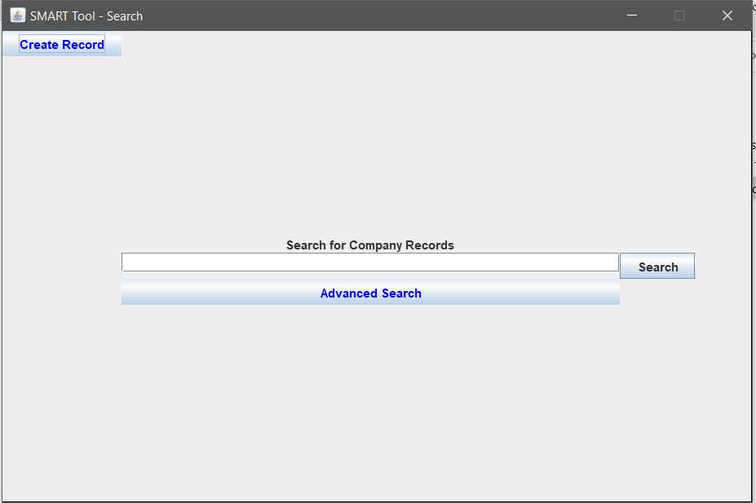
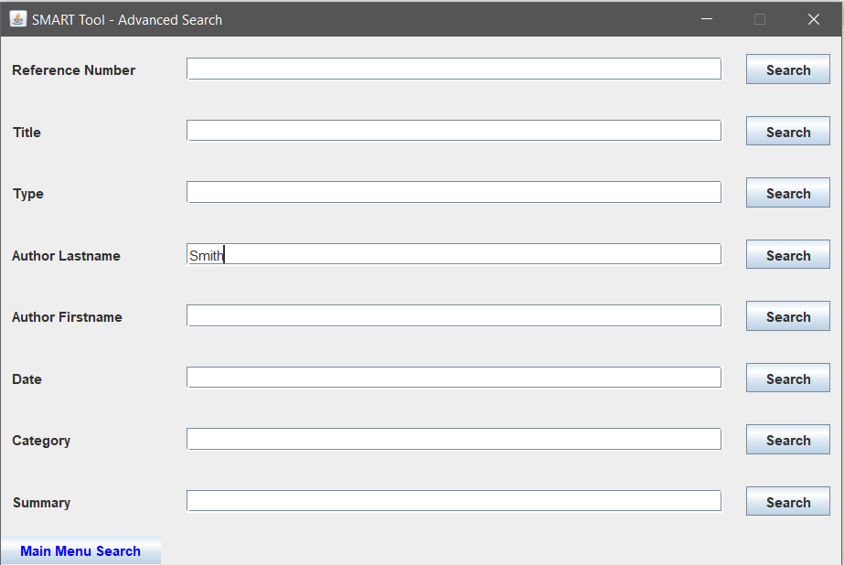
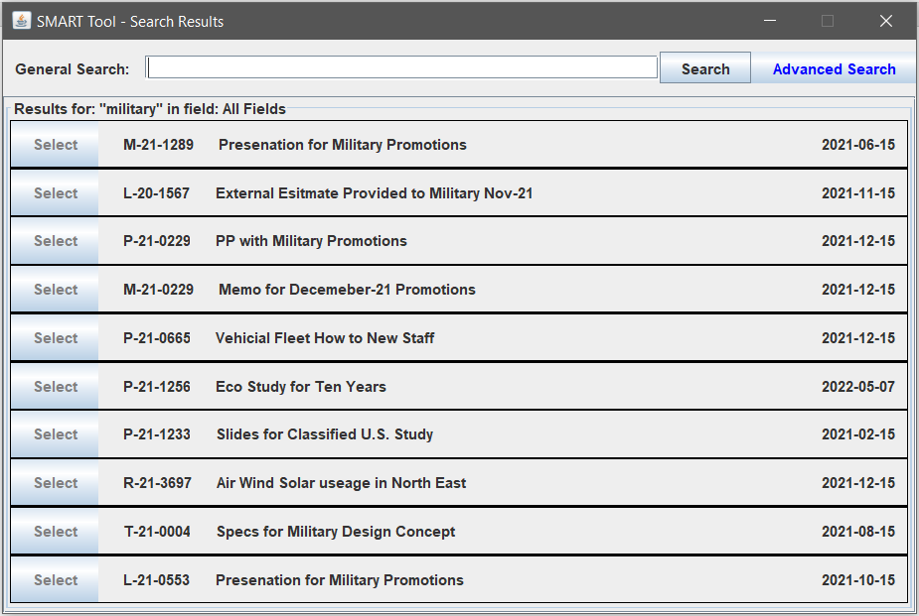
SMART Demo (continued)

Slide 9








Future Enhancements & What’s Possible
Deliverable
Assigned Ref#
Generate Routing
Review Document
Final Approved
Document Inventory
More Metadata
Searchable Records

Slide 10
Thank You
Brian Kilheffer
Samuel Scalf
Chris Ames
Josh Longo
Akane Amagai
Young Jin Jeon

